Slide 1
Course Recommender
CS 6235 Real Time Systems
Chaitanya R Maniar
Ishika Roy
Sampada Upasani

Slide 2
Agenda
Motivation
System Architecture
Project Overview
Implementation
Recommendation algorithm
R Shiny framework
Demo
Future work

Slide 3
Motivation
Challenges faced by students:
Lack of knowledge about which courses to follow
Sequence of courses
Majority choose according to friend’s/senior’s recommendations
Proposed solution:
Course recommender system
Takes advantage of collaborative experience of graduated students/alumni
Predicts appropriate courses for current students

Slide 4
Project Overview
Consists of two phases:
Off-line phase:
Generate a student and courses database
Generate association rules using former student database
On-line phase:
Store user information
Recommend courses based on user input

Slide 5

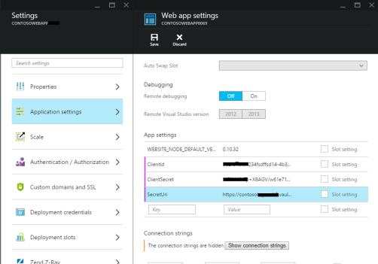
System Architecture
Former Student Database
Off-line phase
Authorization and registration
Data mining
Rules Database
Courses Database
Rules
Recommendation algorithm
(Apriori)
User Input
Recommendations
Web App
On-line phase

Slide 6





Implementation
R Packages:
Shiny
Shinydashboard
Arules
stringr
datasets
Databases
Implementation
ShinyApps.io
Shiny dashboard

Slide 7
Recommendation
Two-step approach:
Frequent itemset generation:
Determine frequent item sets from data
Rule generation:
Generate high confidence rules from each frequent itemset

Slide 8
The Apriori Algorithm
The Apriori Principle -
“If an item set is frequent, then all of its subsets must also be frequent”
Association rule -
An implication expression of the form X -> Y, where X and Y are item sets.
Ex: {Course1} -> {Course2}

Slide 9
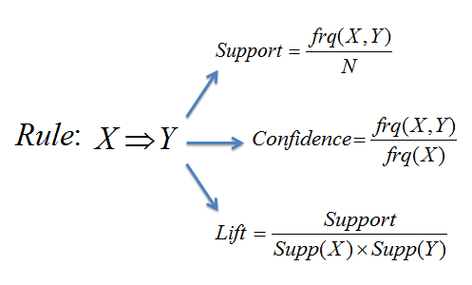
The Apriori Algorithm
Support –
proportion of transactions in the data set which contain the item set
Confidence –
the probability of finding the RHS of the rule in transactions under the condition that these transactions also contain the LHS
Lift –
measure of the performance of a rule at predicting cases that have an enhanced response

Slide 10


R Shiny
Web application framework for R – built by RStudio; GPL – 3 | file LICENSE
“Reactive” binding between inputs & outputs
Web deployment – Shinyapps.io (cloud based service by RStudio)
Every Shiny App :
server.R ui.R

Slide 11
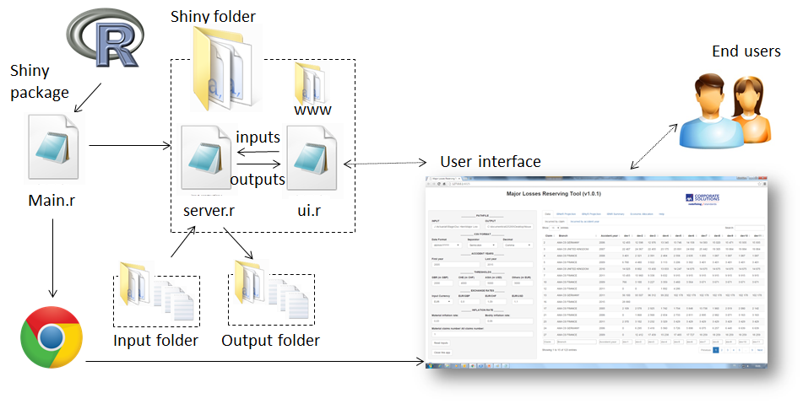
R Shiny Framework

Slide 12
Demo
https://rts-course-recommender.shinyapps.io/course_recommender_system/

Slide 13
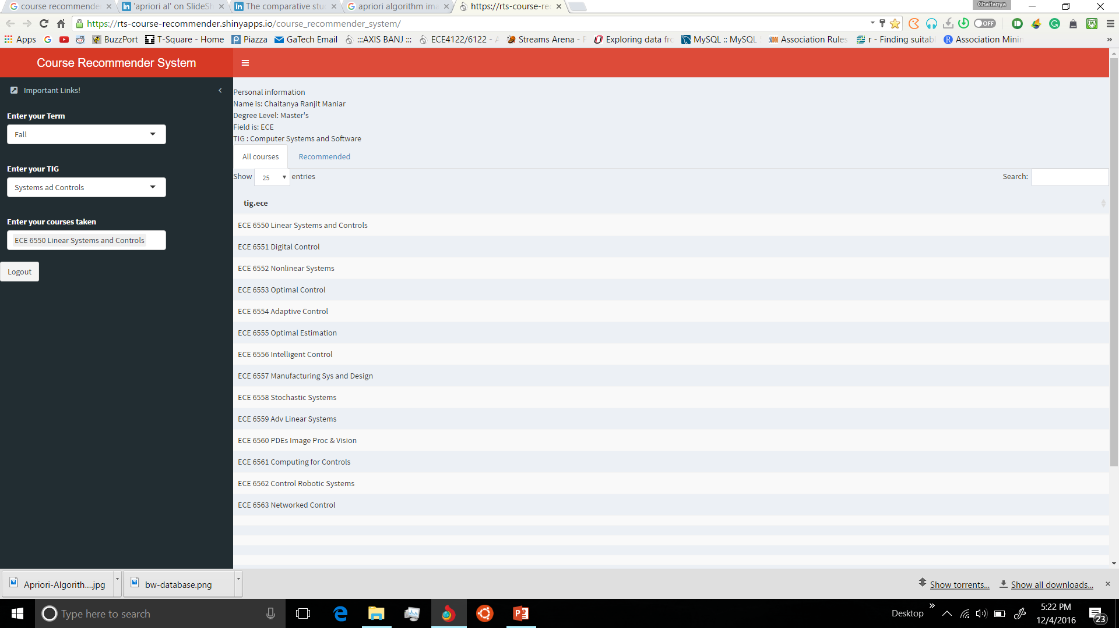
Course List by TIG

Slide 14
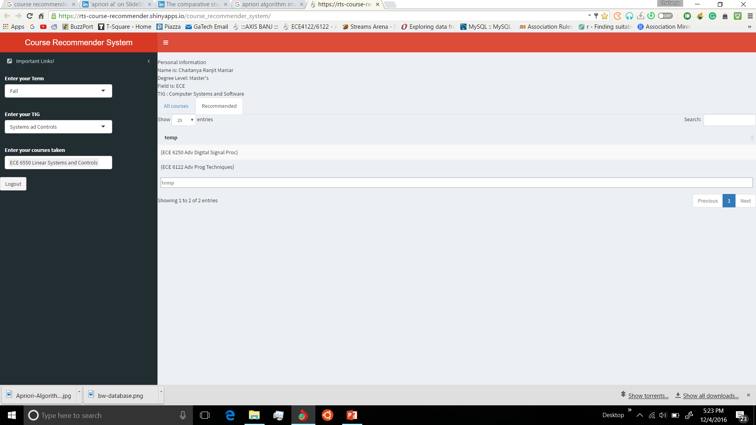
Courses Recommended

Slide 15
Limitations
Cold Start Problem
Cross Listed Courses & Prerequisites
Recommendation by “popularity” - subjective

Slide 16
Future Work
Including other departments and different universities
Adding more features - course rating system, feedback system, integrating recommendation with average grades
Recommendation by course relevance (course weights)
Recommending online courses (MOOC)

Slide 17
Thank You!!

